Slide 1
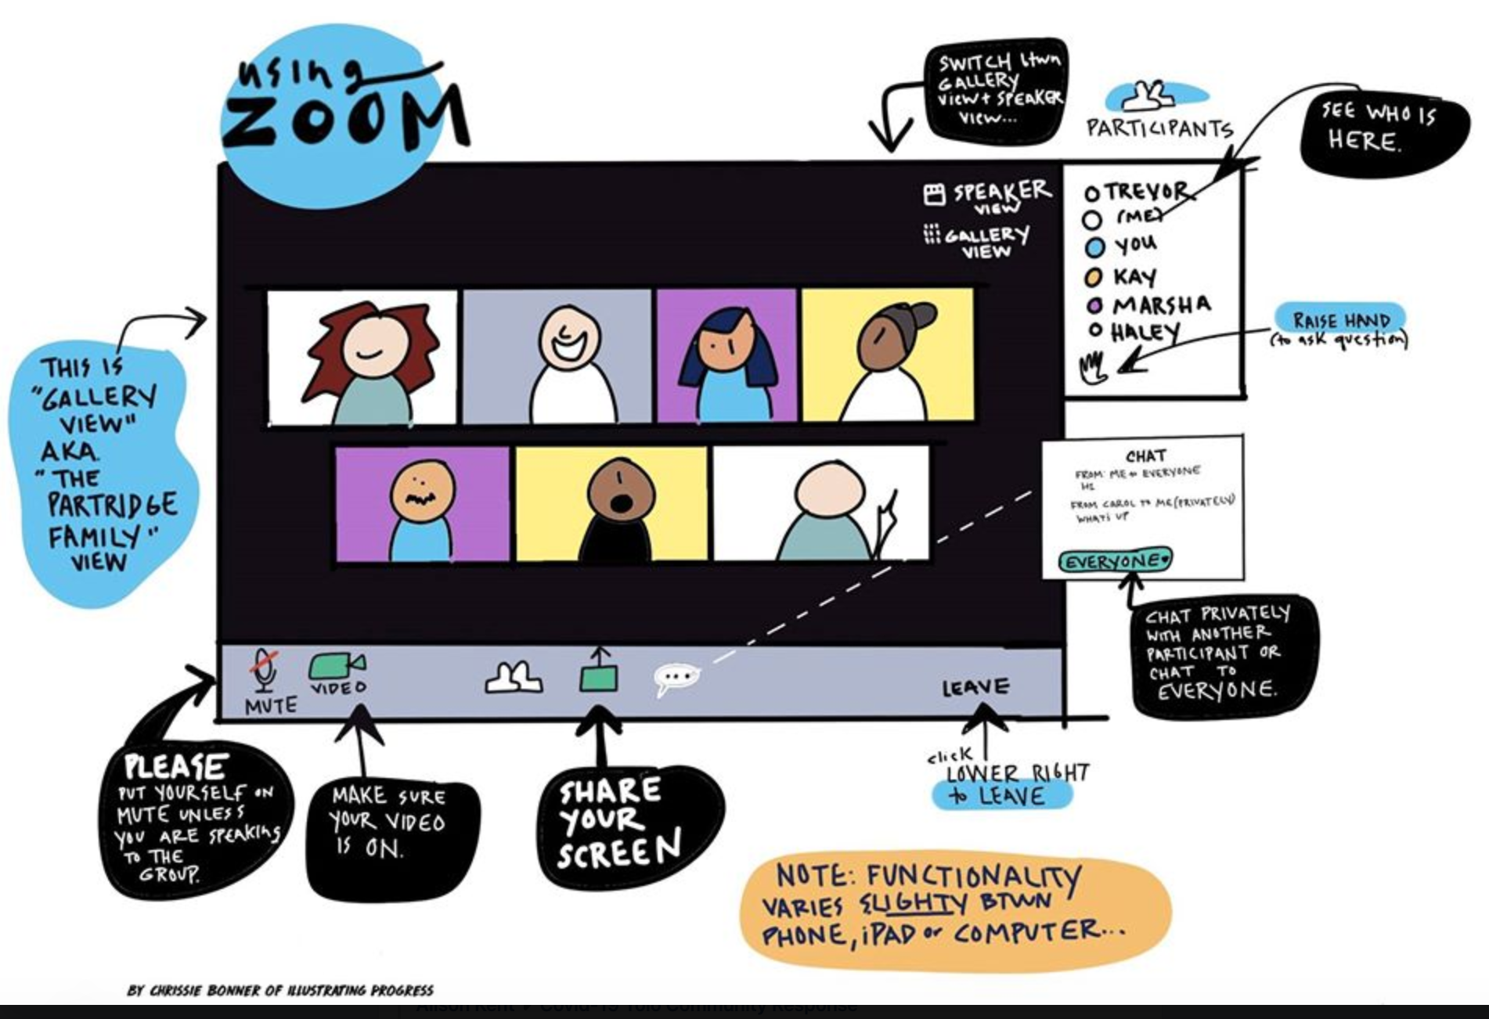
Lisa & Adam
Notes:
Adam what organisations or PCNs do we have in the lounge today?
Say hello
Zoom etiquette

Slide 2
Today’s learning lounge will be a
90-minute introduction to workforce planning
with short breaks for reflections and Q&A.
Notes:
Today’s learning lounge will focus on workforce planning
for the next 85 minutes with a short break half way through for reflections and Q&A and again at the end of the session.
This is just a 90 minute introduction
To give you an overview of workforce planning to help you think about how to get started and the models and processes to use.
Brought to you from the Nottinghamshire Alliance Training Hub (NATH as we like to be called) and the ICS.

Slide 3
How would you rate your workforce planning knowledge?
1. No knowledge
2. Some knowledge
3. Good knowledge
Notes:
Adam shall we do the first poll?

Slide 4
Learning outcomes from today’s virtual learning lounge
Acknowledge a definition of workforce planning.
Learn the 5 elements of workforce planning.
Appreciate the wider factors to workforce planning - consider how to add value! (getting from A to B).
Understand the key reasons and benefits of effective workforce planning and mindset.
Appreciate the link between effective workforce planning - 80/20 Pareto principle.
Understand the need for quality data.
Overview of 2 workforce planning process models and HEE Star.
Consider the wider considerations of the workforce pipeline and how to ‘close the gap’.
Understand a continuous improvement model.
Greater awareness to workforce planning process to inform decision making, drafting and submitting workforce plans.
Notes:
Learning outcomes from today’s virtual learning lounge are:
1. Acknowledge a definition of workforce planning and learn the 5 elements of workforce planning.
2. Appreciate the wider factors to workforce planning tactics and strategies and consider how to add value! (getting from A to B)
3. Understand the key reasons and benefits of effective workforce planning; criteria and mindset.
4. Appreciate the link between effective workforce planning, the 80/20 Pareto principle and the need for quality data.
5. Overview of 2 workforce planning process models.
6. Overview of the HEE Star to support workforce transformation.
6. Consider the wider considerations of workforce supply and demand pipeline and how to close the gap.
7. Understand a continuous improvement model – PDSA to workforce planning.
8. Greater awareness to workforce planning process to inform decision making, drafting and submitting workforce plans.

Slide 5
Introduction
Workforce planning is often mentioned - but rarely explained.
In many health and care organisations to include PCNs and GP practices the habitual approach to workforce planning is just a short-term budget and headcount exercise.
This is not useful when looking at sustaining your organization/ PCN/GP practice.
Notes:
In today’s climate of uncertainty and the variable health and social care working environment – effective workforce planning is a critical business process.
Workforce planning is often mentioned - but rarely explained.
In many health and care organisations the habitual approach to workforce planning is just a short-term budget and headcount exercise.
This is not useful when looking at sustaining organisations or indeed PCN’s.
Workforce planning does not need to be complicated and any necessary complexity can be adjusted to suit the size and maturity of your primary and community care organisations.
When workforce planning is non-existent or ineffective, organisations become reactive, and tend to rely on ‘hiring and firing’ than focusing on the longer term investment – sustaining the organisation or your PCN.

Slide 6
Workforce Planning Definition
“Workforce planning is a process of analysing the current workforce, determining future workforce needs, identifying the gap between the present and the future, and implementing solutions so that an organisation can accomplish its mission, goals, and strategic plan.”
CIPD, 2018
Notes:
So what is workforce planning ?
I have selected what I thought was the most suitable workforce planning definition:
“Workforce planning is a process of analysing the current workforce, determining future workforce needs, identifying the gap between the present and the future, and implementing solutions so that an organisation can accomplish its mission, goals, and strategic plan.”
CIPD, 2018

Slide 7
Workforce planning has five elements
The goal of effective workforce planning is to have a workforce with the
right size, right shape, right cost and the right agility.
Notes:
Workforce planning has five elements:
It has to be the right size.
It has to be the right shape.
It has to be the right place
It has to have the right skills.
The right costs.
So the goal of effective workforce planning is to have a workforce all these elements in place.

Slide 8
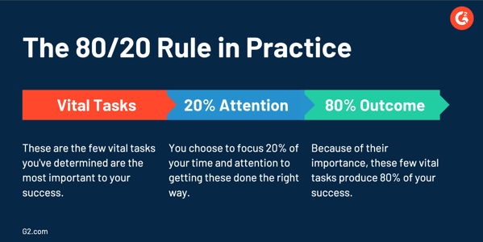
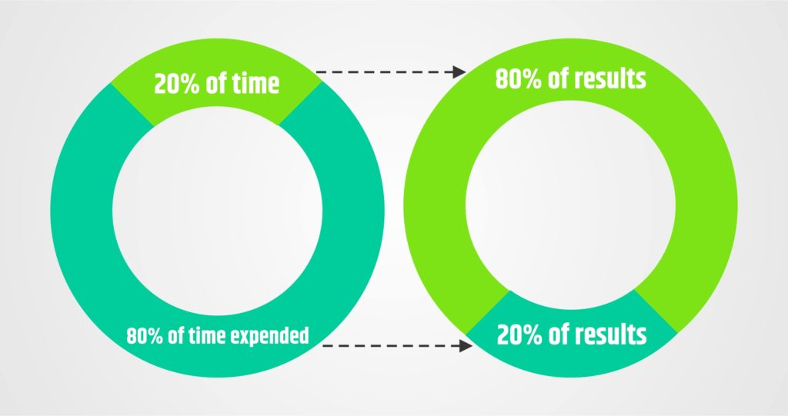
80/20 Pareto principle
Effective workforce planning follows the 80/20 Pareto principle.
80% of the effect is achieved by only 20% of the work –
The workforce planning is the vital task (process) to your
organisation or PCN success.
Notes:
Has anyone heard or can recall the 80/20 Pareto principle?
JUST a thought…
Effective workforce planning follows the 80/20 Pareto principle.
It could be argued that 80% of the effect is achieved by only 20% of the work.
If this is the case, workforce planning is a vital task/process to your organisation or PCN success.
In the workplace, the Pareto principle means that 80% of the responsibility and work are shouldered by only 20% of your employees. Meaning, most of the work and effort are from the minority of your staff.
So its vital to do workforce planning in order to retain and recruit the 20% of the people that shoulder the 80% of the work outputs.

Slide 9
PCN Workforce Development Plans
Workforce Planning
Current Workforce
PCN DES Service Specification Delivery & the new roles
Patient Need (Population Health Management)
Taking the time to collate, record and report workforce data at a local, regional and national level is critical to the success of the PCN!
Workforce planning is critical to the success of population health management!
Notes:
Would anyone like to talk through their PCN Workforce Development Plan that they submitted and are due to submit at the end of Oct ?

Slide 10
PCN
New Roles
Health & Wellbeing Coach
2021/21
AfC Band: Up to 5
Reimbursement: £35, 389*
First Contact Physiotherapist
2020/21
AfC Band 7-8a
Reimbursement: £55,670*
Care Co-Ordinator
2020/21
AfC Band: 4
Reimbursement: £29,135*
Clinical Pharmacist
2019/20
AfC Band 7-8a
Reimbursement: £55,670*
Nurse Associate
2020/21
AfC Band: 4 (Trainee Band 3*)
Reimbursement: £24,157* & £21,142*
Chiropodist/Podiatrist
2020/21
AfC Band: 7
Reimbursement: £53, 724*
Pharmacy Technician
2020/21
AfC Band: 5
Reimbursement: £35, 389*
Physician Associate
2020/21
AfC Band: 7
Reimbursement: £53,724*
Community Paramedic
2021/22
AfC Band: 7
Reimbursement: £53,724*
Mental Health Practitioner
2021/22
AfC Band: TBC
Reimbursement: TBC
Occupational Therapist
2020/21
AfC Band: 7
Reimbursement: £52,724*
Social Prescribing Link Worker
2019/20
AfC Band: Up to 5
Reimbursement: £35,389*
*Maximum reimbursement rate
Correct as of September 2020
Dietician
2020/21
AfC Band:7
Reimbursement: £53,724*
Notes:
Here we have presented the 13 new roles for primary care. These new roles should aid your organisation – PCN – practice success and build your team.
Possibly help to improve your workforce culture.
Keep an eye on the current roles.

Slide 11
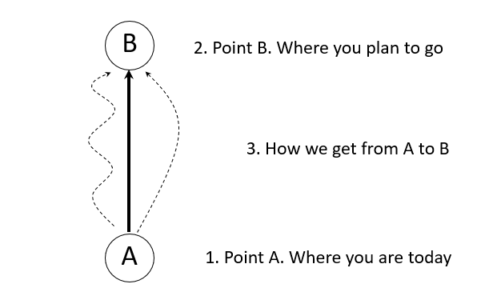
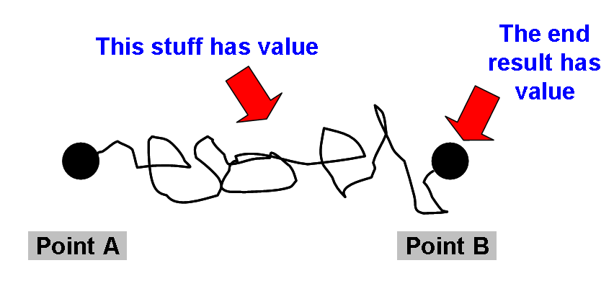
Thinking about the people strategy?
The bit in the middle is workforce planning
Sustaining your organisation or PCN
Notes:
Lets stop here to reflect.
What is your people strategy?
How does it link into population health management for example?
Do you have a workforce challenge?
Was is this challenge?
How are you go to get from from you are today to where you want to be? This is your people strategy?
The bit in the middle is workforce planning.

Slide 12
Workforce planning mindset
Evidence based approach
People with the right capabilities
Scenario planning is critical
Business alignment to your strategy
Understand and challenge demand assumptions
Risk mitigation focused
Future focused – in particular on population health management
Notes:
Its important to have the right mindset for workforce planning
Workforce planning is not merely a process, it is also a mindset – involving thinking and analysis.
Generating information/data and analysing it to inform future workforce demand for people and skills.
Translating the information/data into a set action plan that will develop and build on the existing workforce to meet the demand.
Workforce planning can vary in timeframe, scale and the types of role covered.
Focus – e.g. Population health management.

Slide 13
Key reasons for workforce planning
Demographic
Cost reduction
Talent management
Flexibility
COVID-19/Future virus
NHS People Plan, 2020/21: 1. Looking after our people. 2. Belonging in the NHS.
3. New ways of working and delivering care 4. Growing for the future.
Notes:
So here we are highlighting the key reasons for workforce planning:
DEMONGRAPHIC reason - An ageing workforce poses a number of different challenges for you and your organisation including lack of in-demand skills, upskilling, reskilling and mass retirement.
Cost reduction: Being asked to work ‘smarter’ with a reduced budget.
NHS budget.
Ageing workforce is a more expensive workforce with their annual salary increases.
Talent management: Talented employees form an advantage for you and your organization – they are your pipeline of workforce capabilities – The action and value of turning the tap on!
Flexibility: The need to work faster and smarter.
Remember the tactics that got us here will not get us where we need to be (the future).
COVID-19: Working remotely and innovatively and the loss of staff on a short term or long term basis.
Increase of patient service demand with different needs.
NHS People Plan, 2020/21: 1. Looking after our people. 2. Belonging in the NHS.
3. New ways of working and delivering care 4. Growing for the future.

Slide 14
Key benefits of effective workforce planning
Reduce organisational risks.
Improve patient care and access to quality services through quality workforce data intelligence.
Identify and respond to changing patient needs.
Reduce labour costs (e.g. locums/cancellation of appointments, sick leave, HR) in favour of workforce deployment and flexibility.
Identify relevant strategies for focussed people training and development.
Improve employee retention – growing your own.
Improve productivity and quality outputs.
Identify skills gaps and areas of succession risk.
Make recommendations to deliver strategic value through identified talent within your organisation.
Use workforce plans to bid or apply for funding to help sustain your organisation.
Achieving an integrated workforce across a PCN for example.
Complete workforce development plans e.g. PCNs.
Target inefficiencies (80/20 Pareto principle).
Improve employees’ work-life balance (NHS People Plan 2020/21).
Notes:
Here we have listed the key benefits of effective workforce planning

Slide 15
Key benefits inform HR practice
Organisational design and development.
Succession planning.
Work-life balance initiatives such as flexible working and health well-being support.
Recruitment and selection.
Retention planning.
Talent management.
Job design or redesign.
Career planning.
Learning and development focus.
Reward and recognition.
Notes:
The key benefits to inform HR practice have been highlighted here:

Slide 16
Importance of Knowing your Workforce Data
Effective strategic workforce planning requires access to good workforce data.
Good-quality information is vital for good planning and this information must flow both from within the organisation and from external sources.
Please place a comment related to your challenges and constraints – we might be able to help!?
Does everyone complete workforce data returns?
How much effort is put into completing workforce surveys?
What approach are you taking in your PCN to complete your workforce development plans?
Notes:
Effective strategic workforce planning requires access to good workforce data.
Good-quality information is vital for good planning and this information must flow both from within the organisation and from external sources.
Shall we stop here and reflect again?
Ask the questions.

Slide 17
Is workforce planning a priority function
in your organisation – PCN?
If no, why not?
Notes:
Lets take a break of xxxx minutes whilst doing so please consider this question:
Is workforce planning a priority function in your organisation – or PCN. If no, why not/.

Slide 18
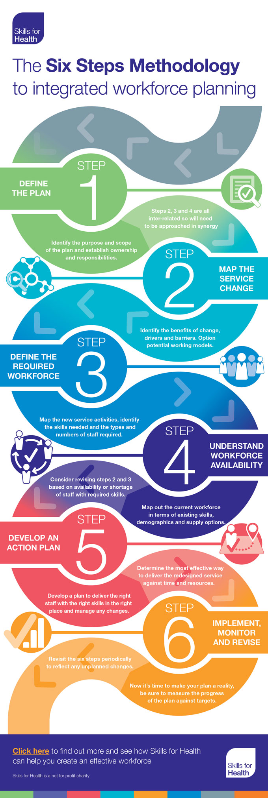
Workforce Planning – 2 Models examples The stuff in the middle
Notes:
Can you recall the previous discussion about the stuff (tasks) in the middle to get you from A to B?
Well here are a couple of models to step you through from getting from A to B.

Slide 19
The Six Steps are:
Step 1: Defining the plan
Step 2: Mapping service change
Step 3: Defining the required workforce
Step 4: Understanding workforce availability
Step 5: Planning to deliver the required workforce
Step 6: Implement, monitoring and refresh
Source: Skills for Health, 2020
Notes:
Model 1.
The Methodology identifies those elements that should be in any workforce plan.
It was designed by Skills for Health.
It take into account the current and future demand for services.
It recognises the local demographic situation and the impact on other services.
Whilst helping you work to the budget you can afford.
This is a model you might what to use, but I will talk you through another model.

Slide 20
CIPD 6 Steps in Workforce Planning
Can be an interactive and not just a linear process!
Start with your organisational strategy, goals and business plan ?
Source: CIPD, 2020
Notes:
Model 2
Is very similar to model 1 but starts with your organization strategy, goals and business plan.
It was designed by CIPD – The Chartered Institute for Professional Development.
In simple terms where you are now and where you want to be.
I will talk you through each step.

Slide 21
Step 1: Understand the organisation and the operating environment
What does the organisational or PCN structure look like now
and what’s likely in the future?
What are the plans to increase productivity,
including changes to organisation or PCN structure and processes?
Are there intentions to introduce or update technology,
remembering people remain at the heart of work?
Notes:
Talk them through each step

Slide 22
Step 2: Analysing the workforce
Identify the knowledge, skills, abilities, demographics, talent profiles, attrition (loss) rates and other factors such as employees’ views on job security,
satisfaction and intention to leave.
Include other parameters, such as people by geographical location.
Consider demographic differences within the workforce or contractual differences as to how work is resourced.
Collect and analyse workforce data to provide you with the information you need to develop capability in these areas.
Notes:
In a fast-paced working environment, innovation, agility and resilience are essential to retain competitive advantage.

Slide 23
Step 3: Determine future workforce needs
Identify future skills and capabilities and predict the timeframes involved.
Scenario planning
can show different futures
affecting people requirements.
These exercises can help you
to formulate contingency and adaptive plans
to mitigate potential risks to achieving a future goal.

Slide 24
Step 4: Identify gaps in the workforce
Identify gaps in skills and knowledge to deliver future ‘business’ plans.
Bear in mind that future roles will often involve a greater use of technology and require a greater digital awareness.
Where recruitment, retention, or both, present a resourcing challenge, greater focus will be needed to
build required skills via staff development.
Completing CPD and workforce development surveys important to access funding to development your workforce

Slide 25
Step 5: Develop an action plan that allows for flexibility
An agile workforce who can adapt to change will contribute greatly
to a change-ready organisation which can
proactively restructure as a result of progress.
Notes:
functional, numerical and adaptational flexibility

Slide 26
Step 6: Monitor and evaluate action plans and solutions (PDSA)
A set of actions should be developed and agreed with
appropriate support and information with
regular reviews of the outcomes.
It’s important that clear evaluation processes should be
designed and embedded into all stages of the process.
PDSA

Slide 27
Notes:
Don’t plan anything without using a continuous improvement model to monitor the improvement/change through a continuous cycle.
We really value the use of the PDSA cycle.
Would you like me to talk you through it?

Slide 28
What have your learned so far from the CIPD workforce planning model?
Is the model helpful?
Remember all models can be changed/adapted to suit your working environment/organization/PCN.
Notes:
Lets stop again here and reflect.
Please share what you have learned so far from the CIPD workforce planning model?
Is the model helpful?

Slide 29
Other considerations when thinking about your workforce
Notes:
Lets now highlight the other considerations when thinking about your workforce

Slide 31
The workforce pipeline
Which tap can be increased?
Newly qualified
Apprenticeships
Return to practice
International recruitment
Joiners from NHS
Graduates
Reviewing and adopting our
equality, diversity and inclusion interventions/culture.
Which leaks can be slowed?
Leavers
Leavers from practice
Reduced/flexible hours
Retirements
Retention
Recruitment
Notes:
Anyone heard about the workforce pipeline?
Which tap can be increased?
Which leaks can be slowed?
Can you identify any others interventions?

Slide 32
What can you do to support your workforce pipeline?
Notes:
So lets think about this for a moment?
What can you do and your team to support your workforce pipeline?
Especially in light of the NHS People Plan

Slide 33
How to close the workforce gap
Recruitment
Retention
New roles
(PCN new roles)
Apprenticeships
Change the service delivery model
Notes:
Here are just a few interventions to close the workforce gap?
Recruitment
Retention
New roles
Apprenticeships
Change the delivery model

Slide 34
Student placements and graduates – clinical and non-clinical
Contacts at NATH:
shelly.worsley1@nhs.net for clinical student placements
lisa.soultana@nhs.net for non-clinical student placements & graduates
Emails from NATH
NATH website
NATH monthly newsletter

Slide 35
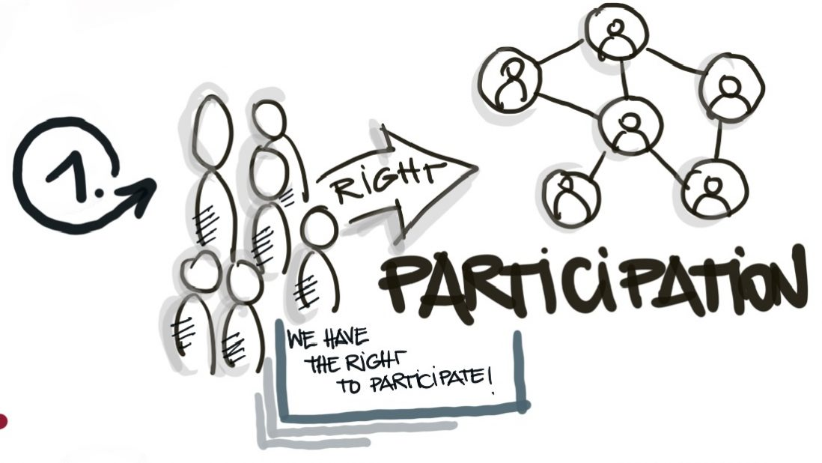
CPD and workforce development funding – clinical and non-clinical
Emails from NATH
NATH website
NATH monthly newsletter
Notes:
There is funding available to support your clinical and non clinical workforce training and development.
Are you participating?

Slide 36
Workforce planning checklist and models
Will be available soon on the NATH website – resources page.
https://www.nottstraininghub.nhs.uk
Email alliance.hub1@nhs.net to register for the NATH monthly newsletter
Notes:
Please check out the NATH website for access to new workforce planning resources
Also register for the NATH monthly newsletter.

Slide 37
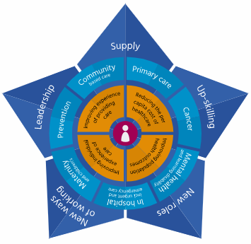
HEE Star to support workforce transformation
Click here to understand the HEE Star
4 new roles and case studies
Adam to share his reflections about the HEE Star
User guide here
Notes:
I will hand you over to Adam to talk you through briefly about the HEE star to support your workforce transformation

Slide 38
Today we hope you have learned about:
1. A definition of workforce planning and the 5 elements of workforce planning.
2. The reason for workforce planning tactics and strategies - getting from A to B and the need for a PDSA.
3. The 80/20 Pareto principle.
3. The key reasons and benefits of effective workforce planning; criteria and mindset.
4. The link between effective workforce planning and the need for quality data.
5. Two workforce planning process models.
6. The HEE Star to support workforce transformation.
7. The workforce supply and demand pipeline and how to close the gap.
8. The importance of workforce planning process to inform decision making, drafting and submitting workforce plans.
Notes:
Today we hope you have learned about:
1. A definition of workforce planning and the 5 elements of workforce planning.
2. The reason for workforce planning tactics and strategies - getting from A to B and the need for a PDSA.
3. The 20/80 Pareto principle.
3. The key reasons and benefits of effective workforce planning; criteria and mindset.
4. The link between effective workforce planning and the need for quality data.
5. Two workforce planning process models.
6. The HEE Star to support workforce transformation.
7. The workforce supply and demand pipeline and how to close the gap.
8. The importance of workforce planning process to inform decision making, drafting and submitting workforce plans.

Slide 39
The right people…
with the right skills…
in the right roles…
at the right time…
and the right cost…
is what will ultimately deliver the
right results
for you and your organisation or PCN.
Notes:
I will finish on a final thought….
Workforce planning is having:
The right people…
with the right skills…
in the right roles…
at the right time…
and the right cost…
is what will ultimately deliver the
right results
for you and your organisation or PCN.

Slide 40
How would you NOW rate your workforce planning knowledge?
1. No knowledge
2. Some knowledge
3. Good knowledge
Notes:
So Adam over to you for our next poll please, then highlight the next slides.

Slide 41
1. How can we help you build your workforce planning capabilities in a follow on
virtual learning lounge?
Notes:
Before we go:
1. How can we help you build your workforce planning capabilities in a follow on
virtual learning lounge?
2. Will you start to champion workforce planning back in your workplace?

Slide 42
Notes:
Good bye for now …. Hope to see you again soon in the virtual learning lounge.

Slide 43
References & resources
https://improvement.nhs.uk/documents/2070/Retaining_Our_People_vf.pdf
https://www.england.nhs.uk/publication/pcn-workforce-planning-template-2020-21/
https://www.england.nhs.uk/gp/gpfv/workforce/building-the-general-practice-workforce/
https://www.skillsforhealth.org.uk/news/latest-news/item/759-primary-care-workforce-planning-support
https://www.skillsforhealth.org.uk/resources/guidance-documents/120-six-steps-methodology-to-integrated-workforce-planning
https://www.cipd.co.uk/knowledge/strategy/organisational-development/workforce-planning-factsheet
https://www.kingsfund.org.uk/blog/2019/05/workforce-implementation-plan
https://www.kingsfund.org.uk/publications/closing-gap-health-care-workforce
https://www.hee.nhs.uk/sites/default/files/documents/HEE%20Star%20user%20guide%20v2.0.pdf

Slide 44
Books
BECHET, T. (2008) Strategic staffing: a comprehensive system for effective
workforce planning. New York: Amacom.
SPARKMAN, R. (2018) Strategic workforce planning: developing optimized talent strategies for future growth. London: Kogan Page.
TAYLOR, S. (2018) Resourcing and talent management. 7th ed. London: Chartered Institute of Personnel and Development.
TRIP, R. and WARD, D. (2013) Positioned: strategic workforce planning that gets the right person in the right job. New York: Amacom.

