Slide 1
Notts ICS
CARE Impacts Report
December 2020

Slide 2
Summary highlights
Notts CARE cohort completed the first phase of development for 24 nurses from General Practice, Community and Care Homes on 25th November 2020
Despite system pressures / COVID, 12 participants are already progressing their projects, with ongoing support available to all
CARE has helped connect nursing teams within PCNs and started to break down entrenched organisational barriers
Ruth May, CNO for England, has been connected directly with one CARE participant (Jamie Woolley, a Care Home nurse) who said this was the first development programme he’d attended that felt relevant to him in his role

Slide 3
Programme Overview
Programme elements | Interventions
CARE is an holistic approach to change that balances practical and personal development with whole system engagement to deliver sustainable population health improvement and workforce resilience by connecting primary care teams with each other, their system and their communities. CARE uses practical population health improvement projects to activate participants and their teams to be the change agents primary care needs. There are 3 key elements to the programme:
System engagement and connectivity | 2 x 1-2 hour workshops attended by participants, their managers and local system leaders at the start and end of their initial development programme. Participants work directly with local and national system leaders to co-design CARE inputs around key system / population health priorities and learn about who, where (structures / forums) and how to influence change to ensure they are front and centre of local system transformation and PCN leadership. NAPC, the CARE faculty (consisting of CARE alumni and supplemented by national primary care leaders and external experts) and local system leaders remain on-hand throughout participants’ development to answer questions, identify options, resolve challenges and share learning. Demonstrating the impact of CARE and the value of GPNs / participants around PCN development – continuous evaluation of learning, the learning experience and the impact of the practical projects to demonstrate value and produce an evidence-base to really change the way the system thinks and operates in the future CARE also helps systems identify and develop a core group of influential system leaders from across primary care, nursing and workforce to ensure CARE principles are embedded at leadership level locally. This is delivered as a 2-day Agents for Change course by ShinyMind.
Supporting workforce resilience and connectivity (Leadership development starting with self) | 4 x 2-hour leadership development webinars over a 4-week period delivered by ShinyMind - proven psychotherapeutic leadership development to help individuals identify the things that are holding them back and giving them strategies to help address this. Access to the ShinyMind app (2,000 licences), which enables participants and the wider primary care / local system workforce to look after their own wellbeing, build resilience, and become part of an active community of support. Participants can go back through the master classes at their leisure for two years.
Population health management (PHM) (Leadership development through practical projects) | 4 x 2-hour leadership development webinars delivered by the National Association of Primary Care (NAPC), the CARE faculty and leaders from the relevant local system. CARE uses projects to activate participants by: working with them to translate complex policy, theory and datasets into simple, practical steps that build on their existing knowledge and skills helping them to use their own insights and practice / PCN data to identify small changes / projects they could make to deliver significant impacts around GP demand and patient outcomes. CARE also supports participants and their systems to identify impact measures as they set up the individual projects and use these to help track impacts and measure ROI.

Slide 4
CARE Programme Evaluation
Nottinghamshire
December 2020

Slide 5
The Impact of CARE in Notts: One-page summary
CARE has helped me
93% of participants felt that their emotional wellbeing had improved and 100% felt that their voice is being heard more
Participants learned skills to enable them to continue to build their confidence and resilience
CARE has helped my patients
100% of participants felt more able to improve the health of their populations and make a positive difference
12 projects were started by participants, aiming to achieve measurable improvements in population health and GP and A&E demand
CARE has helped my team
100% of participants felt that their Leadership and influencing skills had improved
6 new or existing relationships were developed by each participant during the programme. This means that CARE has made a positive difference to 75 NHS staff so far
CARE has helped the system
100% of participants felt that their ability to put ideas into practice had improved and nearly 80% felt that they were much more likely to continue to work in Primary Care
A potential high Return on Investment for the system in terms of improving staff skill, population health, system demand and PCN maturity

Slide 6
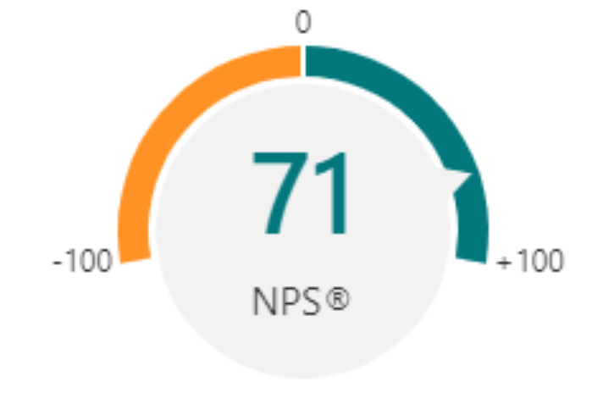
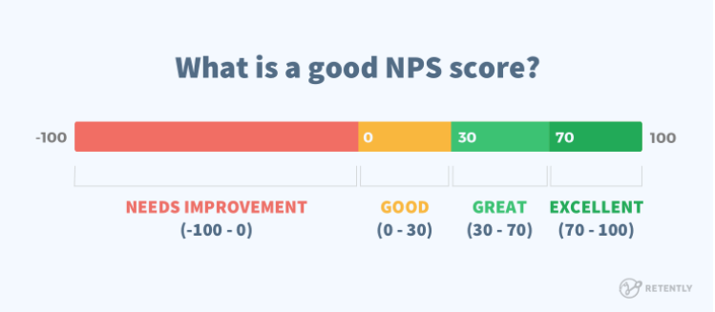
A Net Promoter Score® (NPS) for the CARE Programme
A Net Promoter Score® (NPS) measures customer experience and predicts the growth of a business or an idea. It is the core measurement of customer experience for many organisations.
A NPS rating of 70 or above is rare. It suggests that a product or service is performing at the very highest level and generating significant positive word-of-mouth referrals.
A NPS score of 71 for the CARE programme in Nottinghamshire, suggests that participants are sharing what they have learned to such an extent that others are rapidly taking up these ideas.
Notes:
At a rapid level seen in a social movement = SUSTAINABILITY and GROWTH

Slide 7
CARE Projects to Improve Population Health
Charlotte Gamble | Improving the mental wellbeing of people with dementia using technology and group events to connect and reduce loneliness
Jamie Woolley | Supporting adults with learning disabilities and/or mental health issues with Makaton teaching to improve cognition and wellbeing
Anna Davis | Developing Learning Disability Reviews and NHS Health Checks to be delivered remotely and to include prevention, health promotion and social prescribing
Rachel Harris​ | Using technology to help carers support each other and to help those at risk of diabetes
Sharmin Leach | Supporting at-risk patients who are over 65 and have not had a pneumococcal vaccine with vaccine invitations and advice
Lisa Hodgkinson | Training health care workers to build their knowledge of frailty and the ability to prevent it through interventions
Liz Towlson | Providing exercise programmes for patients with chronic disease, such as qi gong, to improve their physical and mental health
Ryan Alsop | Influencing commissioning to improve access for the LBGT+ community
Victoria Lee | Supporting children and young people in schools and letting young people know what services are available
Kathryn Nussey | Supporting housebound patients in self-management and administering insulin
Janet Redfearn | Increasing update of vaccinations and improving awareness in order to keep older people keep out of hospital
Denise McCoid | Training for care home staff in the administration of insulin
Each project aims to test new ideas and achieve measurable improvements in population health, patient activation and system demand while acting as a vehicle for participants to develop their skills further
Notes:
Include PCN name

Slide 8
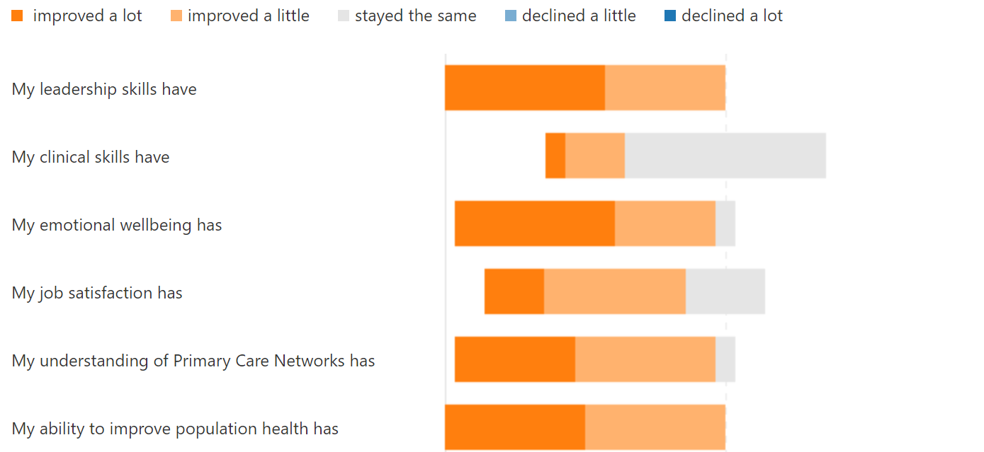
The Impact of CARE in Numbers (1/2)
100% improved
29% Improved
93% improved
72% improved
93% improved
100% improved
Question used as an additional baseline for other questions as CARE does not directly aim to improve the clinical skills of participants

Slide 9
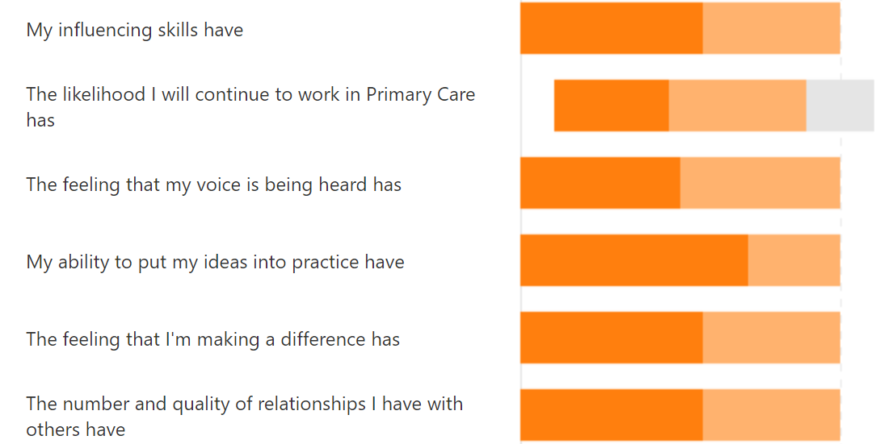
The Impact of CARE in Numbers (2/2)
100% improved
79% improved
100% improved
100% improved
100% improved
100% improved
Each participant put what they had learned into practice and developed over 6 relationships
This means that CARE has made a positive difference to 75 NHS staff so far with the number likely to grow over time.

Slide 10
The Impact of CARE in Words (1/4)
For me it was a journey I wasn't expecting but the CARE Programme helped me through, making me see the world differently and giving me strength. I wouldn't have had the opportunity of making so many connections within the wider system and with other proactive nurses without the programme nor had so many experts in their field supporting and guiding me. I certainly would not have taken up the role of Integrated Care Partnerships' Practice Nurse Lead without this support behind me
Thank-you and I'm so glad that I got to be part of this and feel we are on a really inspiring journey together.
Anna Davis
I feel listened to. Not just as a leader but also within the wider scope of nursing. It has helped with getting my thoughts and feelings grounded and turning them into a help not a hindrance. Also given me some acknowledgment that my ideas can serve a purpose, instead of then being brushed aside as not ‘NHS’ enough.
I have gained more from this than I ever thought I could. It has allowed me to combine my passion for communication and training into something productive that has been hard get off the ground previously.
Jamie Woolley

Slide 11
The Impact of CARE in Words (2/4)
I found the programme has helped me focus on tasks. To look at projects in small bite sized chunks, rather than tackle a big mountain. It has also given me the ability to look at myself and my internal self-doubt, and to see where that has come from. It has also helped me realise that those who I often put on a pedestal will often feel the same as me.
I really enjoyed the sessions. Thank you.
Lisa Hodgkinson
The CARE programme has given me leadership skills that can be put into practice which were taught in a very practical way. The app has been particularly helpful, and I have already been sharing this with my colleagues. Being given the opportunity to improve our networking is key in healthcare and this programme has enabled us to work with our colleagues within our PCN to draw on their skills and specialities to better improve our patient's health.
Charlotte Gamble
The programme has had a very positive impact on me and improved my confidence. Bec’s sessions were very thought provoking and have helped improved my confidence.
Our project is exciting and will hopefully improve the population’s health.
Thank you for the opportunity
Kathryn Nussey

Slide 12
The Impact of CARE in Words (3/4)
Although I have not participated in the programme as a delegate and have been part of the team who organised for Notts, I have truly valued the opportunity and networking this programme has provided. I have learnt a lot from listening to the sessions I attended and when having reflective discussions with delegates. It has been wonderful to see the growth of participants and begin to see the impact happening in our system for our people.
Delivering the programme to nurses working across sectors has been fantastic in terms of integrating our workforce.
Nicola Payne
This has been really influential in terms of networking and the relationship information we learned in the first sessions
It has really made me look at staff behaviour and how this impacts on self, teams and the wider networks and systems.
Would really recommend this programme and the Shiny Mind App - which I have recommended to others
Deb Towers
The sessions with Rebecca have had a big impact on my emotional wellbeing both at work and home. The sessions are always in the back of my mind and the influence how I react to situations.
Thank you for enabling me to network with other member of the PCN and giving me the tools to implement changes now and in the future.
Denise McCoid

Slide 13
The Impact of CARE in Words (4/4)
Connecting with Nursing colleagues and new leaders in our system who needed recognition and self belief and bit of encouragement. Looking forward to watch them develop further and their ideas becomes reality.
Thank you for bringing this programme to Nottingham.
Sonali Kinra
High impact - enjoyed networking with other leaders from across the country and in several different roles. Learned more about myself and my leadership skills and about general practice nursing which will enable me to do my job better in the future.
Esther Gaskill
It has increased my leadership and improvement skills, networking and working in collaboration.
Adam Street
It has supported me to use wellbeing techniques on a daily basis. It has provided me with information need to get a project started.
Ryan Alsop
It has changed my attitude. I am concentrating on where I can make a difference rather than on others.
Rachel Harris
The feeling that I can make a difference made a huge impact on my job satisfaction.
Sharmin Leach

Slide 14
Contact us
Email:
sonali.kinra@nhs.net
nicola.payne8@nhs.net
clare.simpson@napc.co.uk

